Slide 1
BrightTV Viewership Analytics (Insights and Recommendations)
Presenter’s Name: Phuti Mochueneng
Date: 30 September 2025

Slide 2
Agenda
Introduction
Insights on user and usage trends of BrightTV.
Factors influence consumption
Recommendations for Low Consumption Days
Initiatives to Grow User Base

Slide 3
Introduction
BrightTV’s CEO has set a goal to grow the subscription base this financial year. To support this, I’ve analyzed user profiles and viewing sessions to uncover key trends, behaviors, and opportunities.
This presentation shares insights on how users engage with BrightTV, what drives their viewing habits, and what strategies can help increase both consumption and subscriber growth.
Let’s dive in.

Slide 4
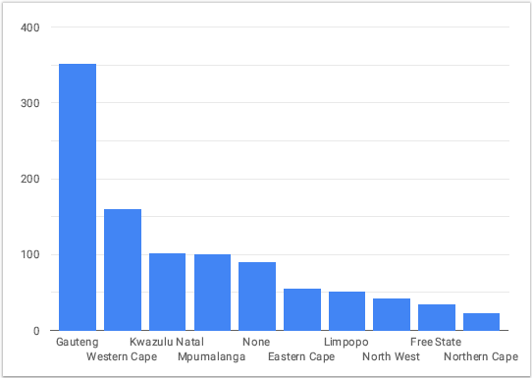
Viewers by Province
Gauteng Dominates User Base
Gauteng has the highest number of viewers by a wide margin — well above 300
Western Cape & KwaZulu-Natal Are Strong Secondary Markets
Both provinces show solid user numbers, indicating strong engagement potential.
We have about 1.0K total Number of Users

Slide 5
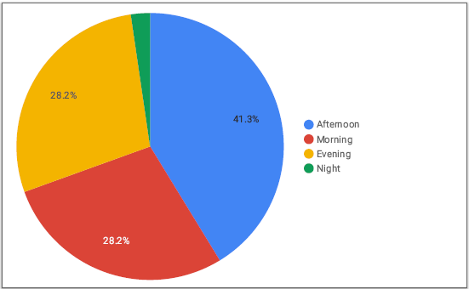
Viewership by Time of Day
Time | Number of Views
Afternoon | 401
Morning | 350
Evening | 232
Night | 17
Highest: Afternoon — 401 views
Lowest: Night — 17 views

Slide 6
Viewership by Race and Gender
Race | Male | Female | None
Black | 377 | 80 | –
White | 144 | 19 | –
Coloured | 123 | 18 | –
Indian/Asian | 49 | 13 | –
Other | 7 | 6 | –
None | – | – | 88
Total | 772 | 149 | 88
Black users are the largest racial group, comprising 46% of total users. White users is 16%, followed by Coloured (14%), Indian/Asian (6%), and Other (1%).
None is 9%, which may indicate gaps in data collection or user privacy preferences.

Slide 7
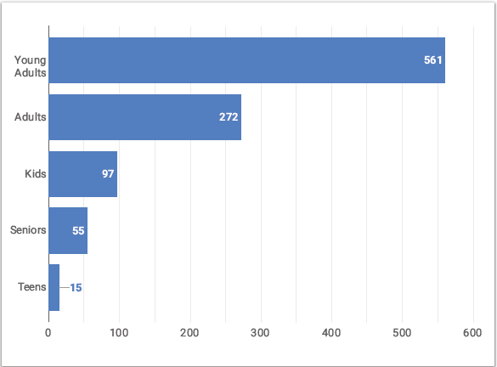
Viewers by Age Group
Age Range | Description
< 13 | Kids
Between 13 and 17 | Teens
Between 18 and 35 | Young Adults
Between 36 and 50 | Adults
> 50 | Adults
Young Adults dominate the user base with 561 individuals — more than double the next group.

Slide 8
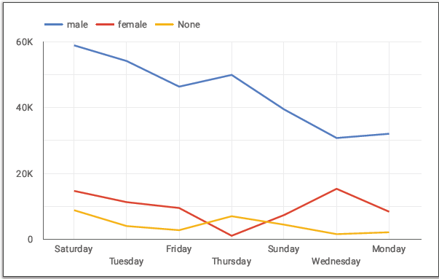
Viewership Duration (Seconds) by Day & Gender
Day | Duration
Saturday | 82,192
Sunday | 50,996
Monday | 42,294
Tuesday | 69,212
Wednesday | 47,397
Thursday | 57,753
Friday | 58,388
Top Performing Days:
Saturday (82,192): Highest duration by far.
Tuesday (69,212): Strong midweek performance.

Slide 9
Top Ten (10) Channels
Rank | Channel Name | #Views
1 | Supersport Live Events | 146
2 | Channel O | 116
3 | Africa Magic | 114
4 | Trace TV | 113
5 | Cartoon Network | 103
6 | SuperSport Blitz | 88
7 | Boomerang | 84
8 | ICC Cricket World Cup 2011 | 50
9 | CNN | 49
10 | E! Entertainment | 43
Live Sports Dominate Viewership:
Supersport Live Events leads with 146 records, and SuperSport Blitz ranks #6 with 88.

Slide 10
Factors Influencing Consumption
Day of the Week: Saturday shows the highest engagement and midweek dips occur on Monday and Wednesday.
Time of Day: Afternoon leads, followed by morning and night is the lowest
Content Type: Sports and music channels (e.g., Supersport Live Events, Channel O, Trace TV) drive the most views.
Demographics: Young adults (18–35) dominate the user base. Black male viewers are the largest segment.
Promotion Timing: Campaigns launched in the afternoon or commute hours perform better.

Slide 11
Content Recommendations for Low Consumption Days
To boost engagement on quieter days like Monday and Wednesday:
  Catch-Up Capsules: Recap top content from the weekend.
  Interactive Polls & Quizzes: Gamified formats to spark participation.
  Behind-the-Scenes or Creator Spotlights: Build emotional connection and loyalty.
  Countdowns or Teasers: Create anticipation for upcoming drops.
  Localized Content: Feature region-specific stories or shoutouts (especially for Gauteng, Western Cape, and KZN).

Slide 12
Initiatives to Grow BrightTV’s User Base
Referral Campaigns: Reward users for inviting friends (e.g., unlock premium content).
Onboarding Series: Short, engaging intro series to showcase platform features.
Demographic-Specific Marketing: Target campaigns to high-engagement groups (18–35, urban clusters).
Content Partnerships: Collaborate with influencers and creators to expand reach.

Slide 13
Thank You

